Slide 1

T07 - Getting Started with PowerShell Core 6.0 for IT Pro's
Sven van Rijen
Product Owner / Senior Engineer
Wageningen University & Research (WUR)
Level: Introductory / Intermediate

Slide 2

About me!
Sven van Rijen
36 years old
Full time in IT since 2002
I live in Wageningen, The Netherlands!

Slide 3
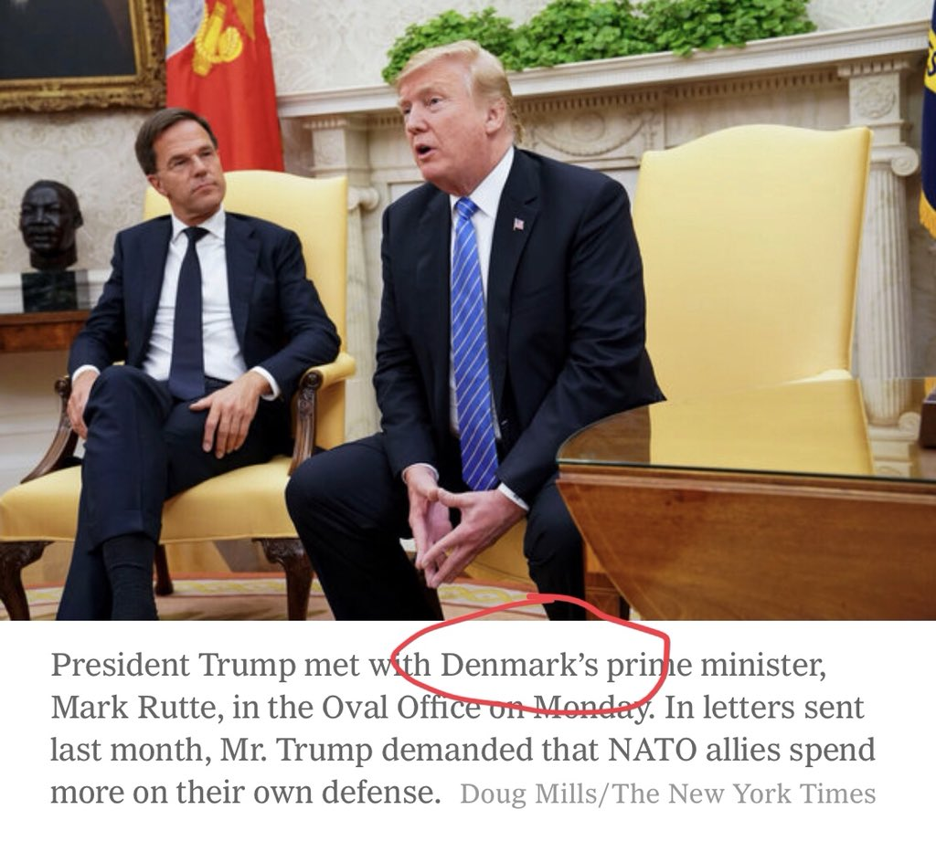

Slide 4
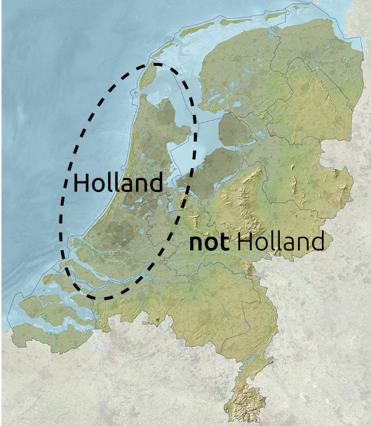

Slide 5


Slide 6
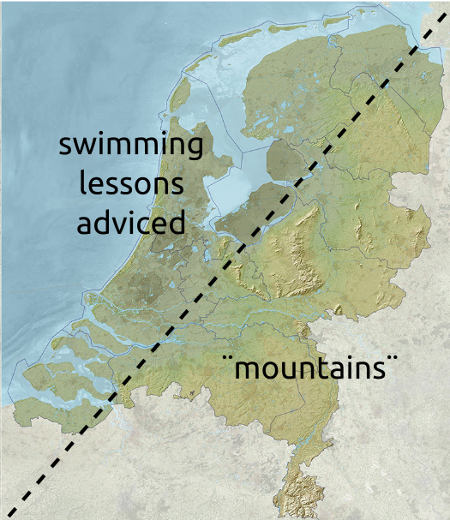

Slide 8

History of PowerShell

Slide 9


Slide 10

Administrators should program faster and more easily—this was provided by having a unified parser and taking over many standard tasks
Monad should be object-oriented and always accept and return .NET Framework objects and not just text
It should be possible to execute scripts remotely on many computers
It should be possible to use GUIs

Slide 11
“Monad is the next generation platform for administrative automation.
Monad solves traditional management problems
by leveraging the .Net Platform”
Monad Manifesto v1.2, Jeffrey P. Snover, Aug 8, 2002

Slide 13
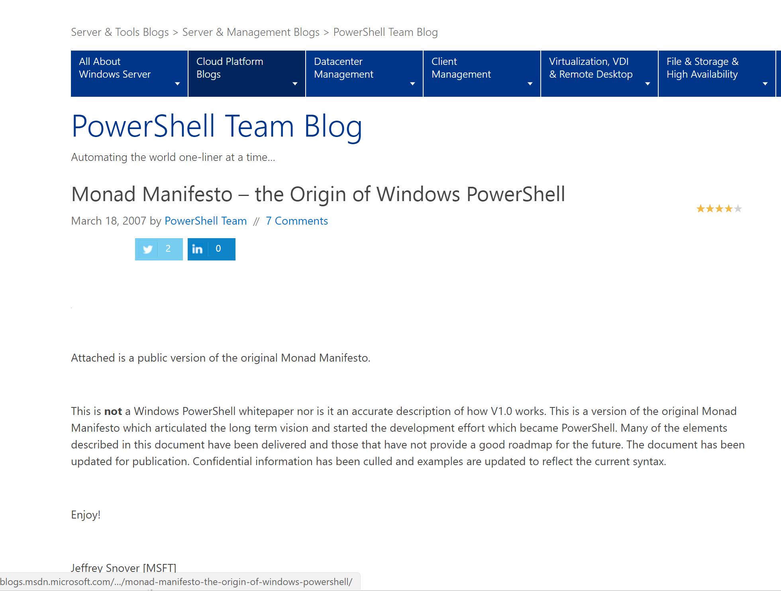

Slide 14
Windows PowerShell version history
(Windows) PS Version | .NET version | date
1.0 | 3.0 | Nov-2006
2.0 | 3.5 (WMF 2.0) | Oct-2009
3.0 | 4.0 (WMF 3.0) | Sept-2012
4.0 | 4.5 (WMF 4.0) | Oct-2013
5.0 | >=4.5 (WMF 5.0) | Feb-2016
5.1 | >=4.5.2 (WMF 5.1) | Jun-2017

Slide 15
DEMO
Get-Process

Slide 16
Wrap-up
Windows PowerShell is built on top of .NET framework
Available on Windows and Windows Server ONLY
Built-in component of WMF

Slide 17
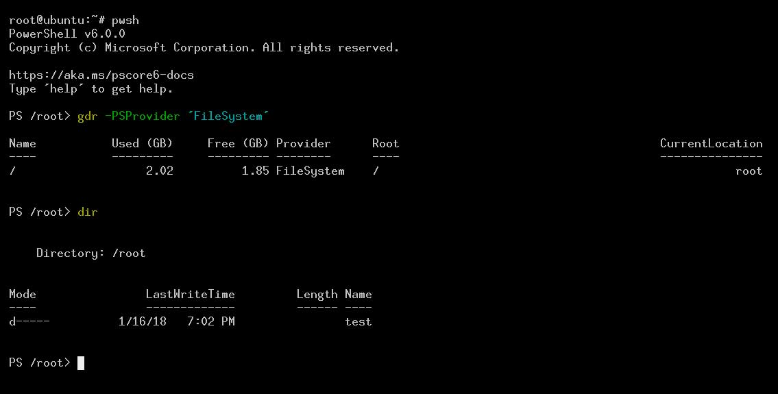
Introducing PowerShell Core 6.x

Slide 18
Why?
Lack of agility/velocity
Lack of visibility
Difficult manual feedback process

Slide 19


Slide 20
Solution
PowerShell is open sourced since August 18, 2016
Source code on GitHub (https://github.com/powershell)
Direct feedback loop with community
Improved visibility into team priorities

Slide 21
Goals of PowerShell Core 6
Ubiquity
Platform independency
Cloud
Community

Slide 22
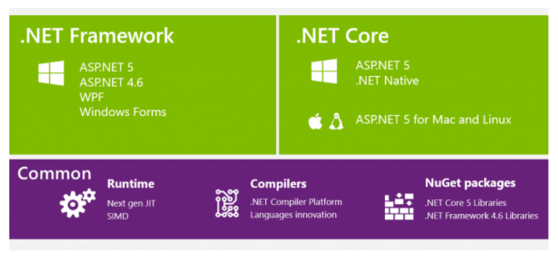

Slide 23
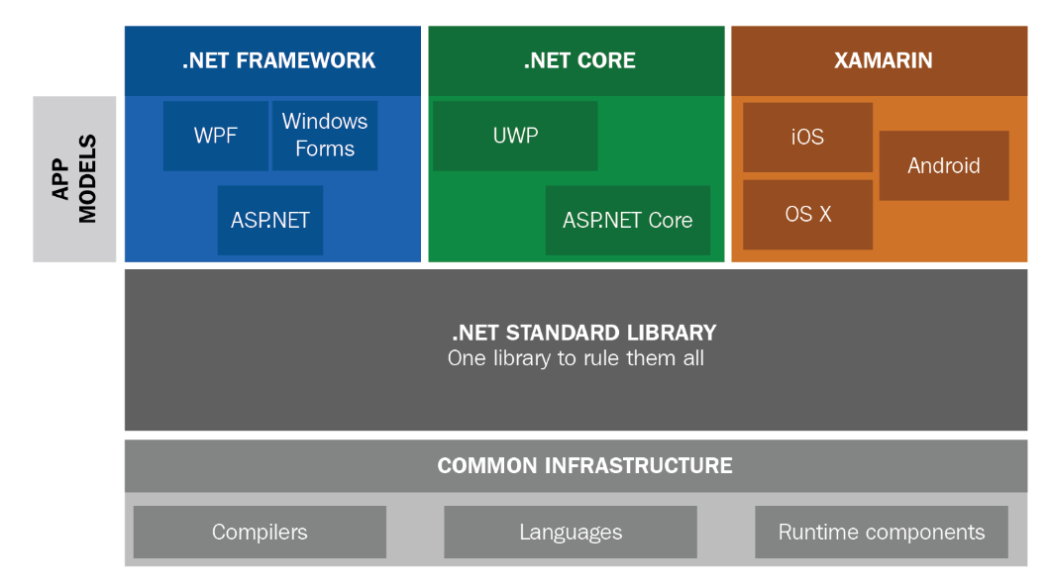

Slide 24
Version history
Version | Date
6.0.0 | Jan-2018
6.0.1 | Jan-2018
6.0.2 | Mar-2018
6.0.3 (current stable version) | Jul-2018
6.1.0-Preview.4 | Jul-2018

Slide 25
DEMO
Install PowerShell Core
Configure VSCode

Slide 26
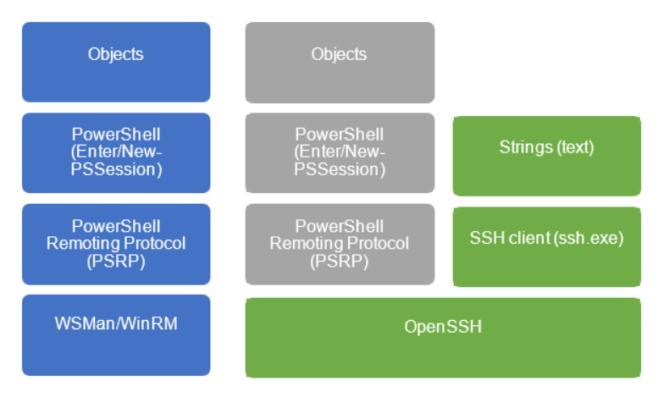

Slide 27
DEMO
Remote Management
WinRM vs SSH

Slide 28
Materials
TechMentor website
Github.com/svenvanrijen/TechMentorRedmond2018

Slide 29
Questions?
Shoot!

Slide 30
Evaluation forms
Please hand them in!

